Slide 1



Centre For Business
Dean's Professional Development Program
Student Guide | Sep 2024

Slide 2
Content
Pages | Content
P.3 | Program Objectives
P.4 | Badge & Awards
P.5 | How to Earn Hours
P.6 | Program Cut-offs
P.7 - 11 | Workflows
P.13-18 | DPDP Portal Navigation
P.20 | Contact
P.21 - 22 | Social Media & Business Student Success Hub
CfB DEAN’S PROFESSIONAL DEVELOPMENT PROGRAM
GEORGE BROWN COLLEGE

Slide 3
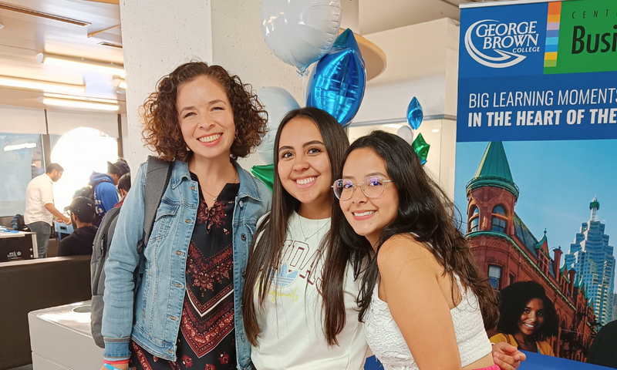
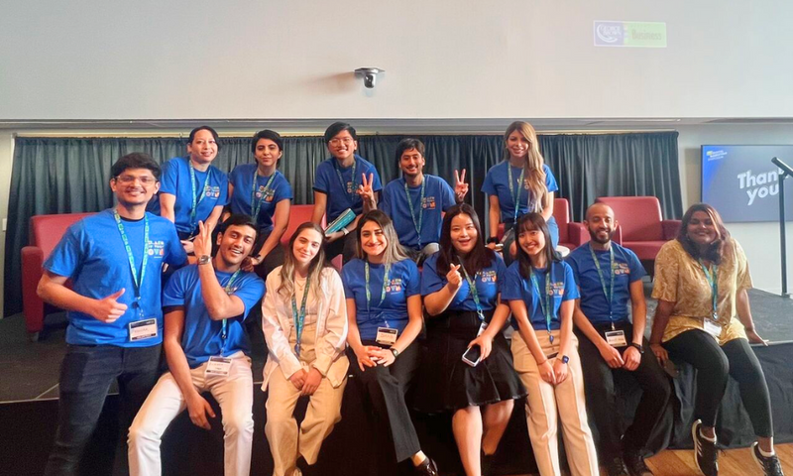
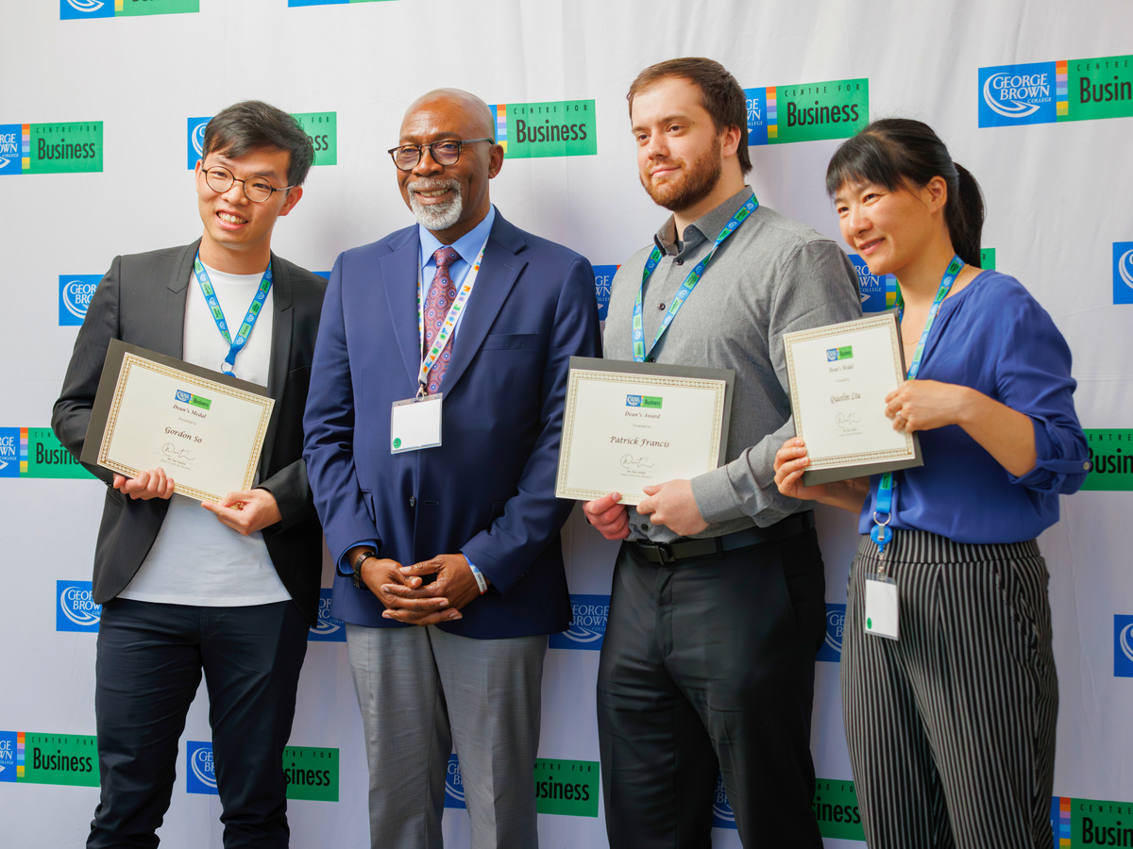
Program Objectives
CfB DEAN’S PROFESSIONAL DEVELOPMENT PROGRAM
Engagement
Connection
Recognition
Encourage student participation in CfB events and activities.
Build community, make connections and create a sense of belonging.
Recognize and acknowledge student contributions with co-curricular records.
GEORGE BROWN COLLEGE

Slide 4
Badge & Awards
CfB DEAN’S PROFESSIONAL DEVELOPMENT PROGRAM
Dean’s Reference Letter
The Top 10 students with the highest amount of hours will receive a Reference Letter from the Dean.
DPDP Badge
Students with 20 hours/+ will receive DPDP Badge on co-curricular records upon confirmation.
Earn Hours
CCR
Updates
Earn hours throughout the semester in DPDP portal.
Experience will also be updated in the Co-curricular record (CCR)
Active Participation
Participate in various events or programs.
(details in next page)
GEORGE BROWN COLLEGE

Slide 5
How to Earn Hours?
Multiple
Hours
Volunteer
experiences
  Volunteer at any CfB events with professional performances
  Volunteer for CfB Prof. Research Projects
CfB DEAN’S PROFESSIONAL DEVELOPMENT PROGRAM
1
Hour
Student engagement events & workshops
  Attend any CfB student engagement event
  Attend any CfB workshop
  Attend Career Fair or other Employer Info Sessions
3
Hours
Career and development events
  Participate on any CfB student panel
  Attend any CfB annual symposium, Dean’s lecture series
GEORGE BROWN COLLEGE
5
Hours
Advance
commitment
  Join a CfB club/association as committee
  Participate in a Case Competition
  Complete the Student-Alumni Mentorship Program
Max. hours per experience

Slide 6
3 Program Cut-offs every year
Spring
Cut-off
Anyone who reached any benchmark by Aug 31
CfB DEAN’S PROFESSIONAL DEVELOPMENT PROGRAM
Fall
Cut-off
Anyone who reached any
benchmark by last day of semester in Dec
Winter
Cut-off
Anyone who reached any benchmark by last day of semester in Apr
GEORGE BROWN COLLEGE

Slide 7
Workflow – Volunteer Experiences
Various
Hours
CfB DEAN’S PROFESSIONAL DEVELOPMENT PROGRAM
Sign up DPDP account
Respond to Volunteer Needs
Got selected for Volunteer Needs
Attend briefing, complete shifts
Hours will be added within 1 week
Receive email from
co-curricular office
Finish reflective questions
Experiences updated in co-curricular record
GEORGE BROWN COLLEGE

Slide 8
Workflow - Student Engagement Events & Workshops
1
Hour
CfB DEAN’S PROFESSIONAL DEVELOPMENT PROGRAM
Event day
Event day
Sign up for student engagement events/ workshops
Eventbrite check-in
Scan to respond
to the Need at DPDP booth
Receive email from CfB Business in 1 week
Follow instructions in email to respond to the need
Due: 2 weeks after the email is sent
1 hour will be added
on DPDP by CfB
Receive email from
co-curricular office
1 hours max. per experience
GEORGE BROWN COLLEGE
Finish reflective questions
Experiences updated in co-curricular record

Slide 9
Workflow - Career and Development Events
3
Hours
CfB DEAN’S PROFESSIONAL DEVELOPMENT PROGRAM
Event day
Event day
Sign up for Career and development event
Eventbrite check-in
Scan to respond
to the Need at DPDP booth
Receive email from CfB Business in 1 week
Follow instructions in email to respond to the need
Due: 2 weeks after the email is sent
3 hours will be added
on DPDP by CfB
Receive email from
co-curricular office
3 hours max. per experience
GEORGE BROWN COLLEGE
Finish reflective questions
Experiences updated in co-curricular record

Slide 10
Workflow – Advance Commitment
5
Hours
CfB DEAN’S PROFESSIONAL DEVELOPMENT PROGRAM
Completed the Student-Alumni Mentorship Program
Finished the term of service in clubs in 1 semester
Participated a case competition
Experience owners will inform CfB team about the experience
or
or
Follow instructions in email to claim the hour
Due: 2 weeks after the email is sent
5 hours will be added
on DPDP by CfB
Receive email from
co-curricular office
5 hours max. per experience
GEORGE BROWN COLLEGE
Finish reflective questions
Experiences updated in co-curricular record

Slide 11
Workflow
DPDP Badge
CfB DEAN’S PROFESSIONAL DEVELOPMENT PROGRAM
2 weeks after semester ends
Semester ended
Reached 20 hours/+
Receive email from
CfB Business with digital badge
Receive email from
co-curricular office
Finish reflective questions
Experiences updated in co-curricular record
Reference letter
from the Dean
GEORGE BROWN COLLEGE
ONLY for the Top 10 students of the semester

Slide 12
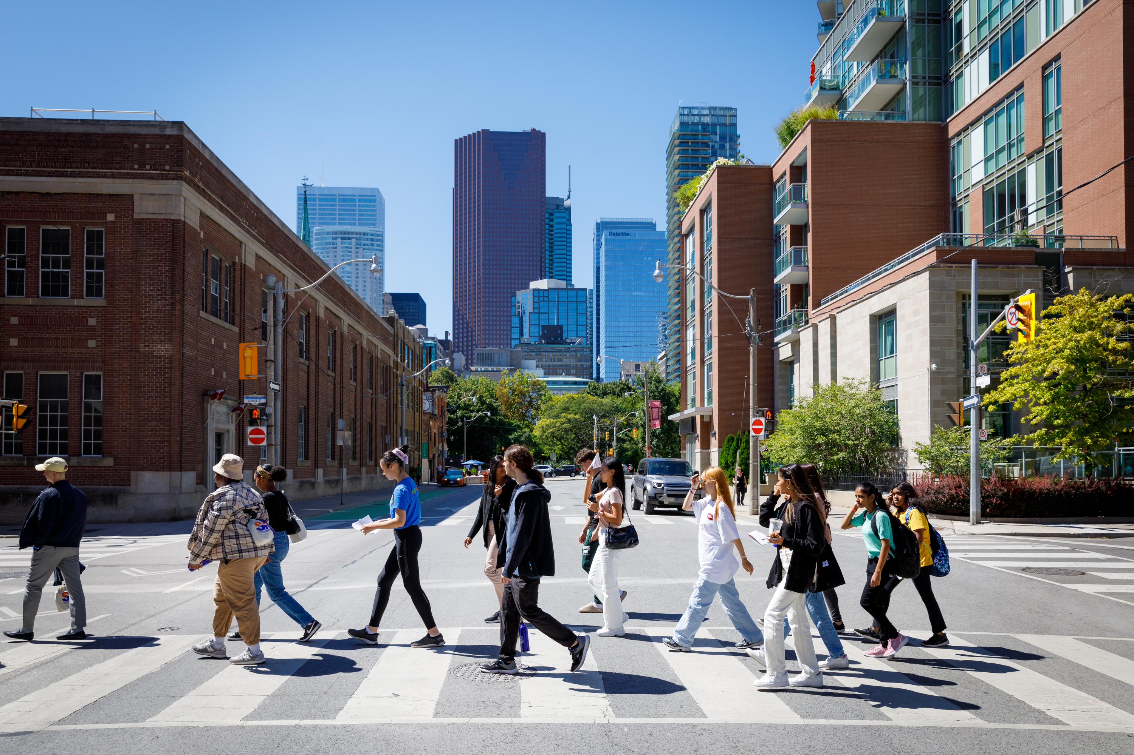
DPDP Portal Navigation
EDIT PRESENTATION TITLE ON MASTER SLIDE
‹#›
GEORGE BROWN COLLEGE
Notes:
3

Slide 13
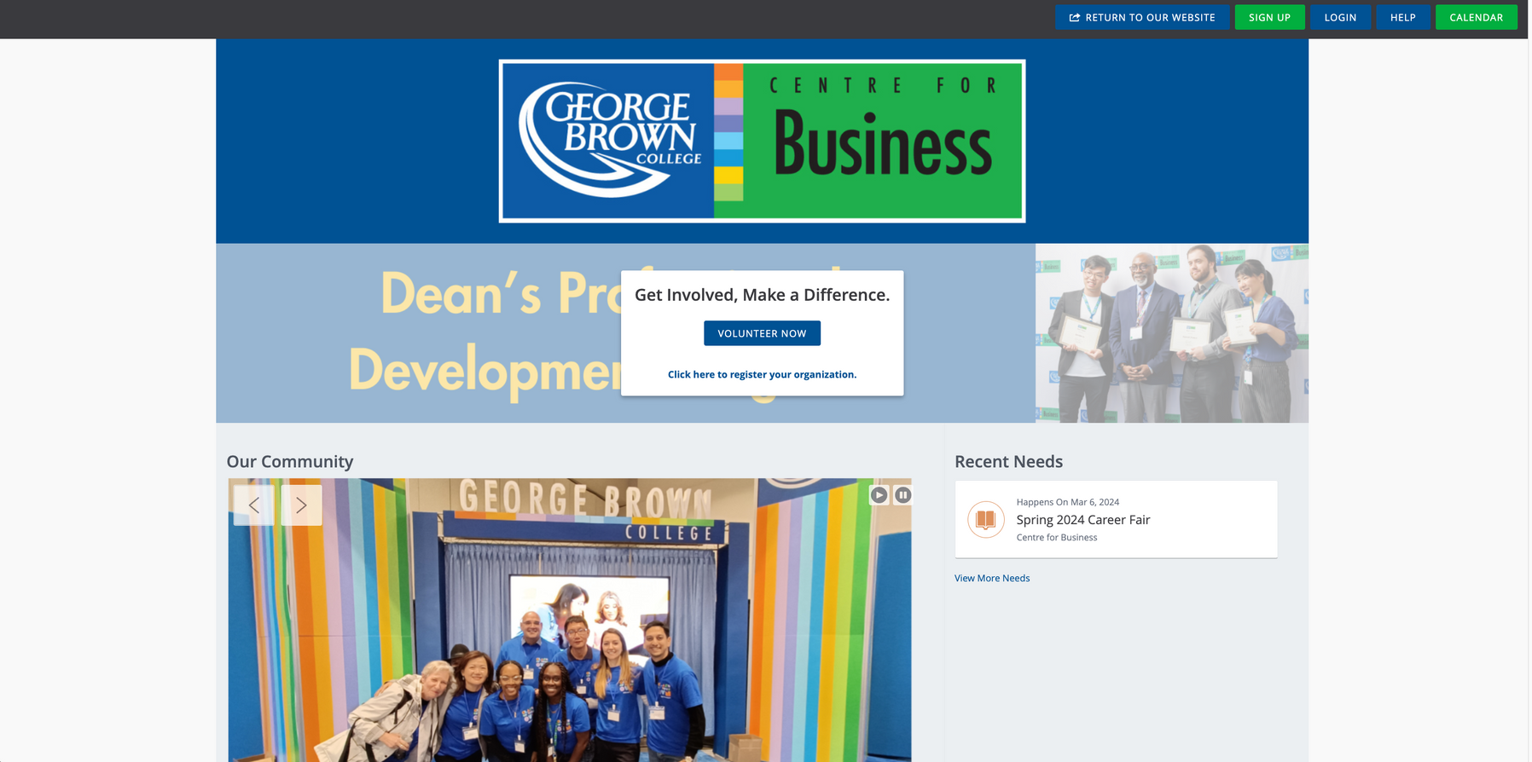
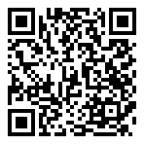

Web page - Get Connected
CfB DEAN’S PROFESSIONAL DEVELOPMENT PROGRAM
GEORGE BROWN COLLEGE
Go to https://centreforbusiness.galaxydigital.com/

Slide 14


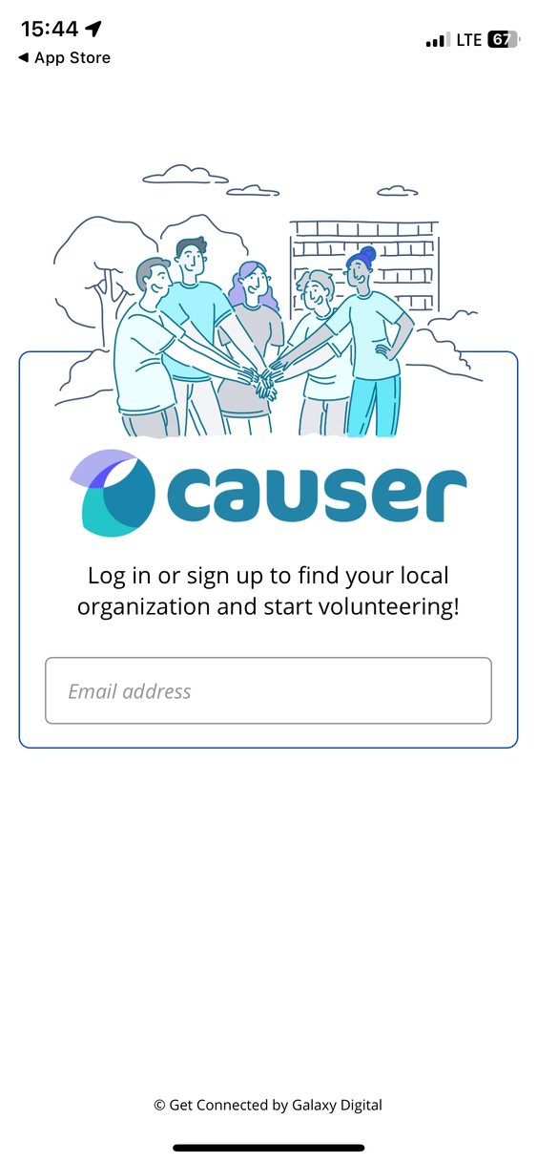
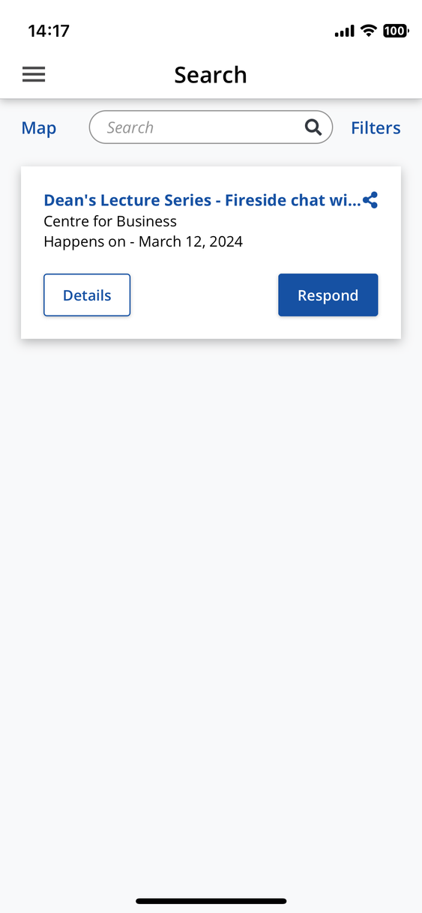
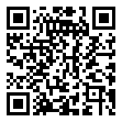

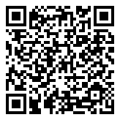
App - Causer - Get Connected
  Register your acc on webpage before logging in to the app
CfB DEAN’S PROFESSIONAL DEVELOPMENT PROGRAM
GEORGE BROWN COLLEGE

Slide 15
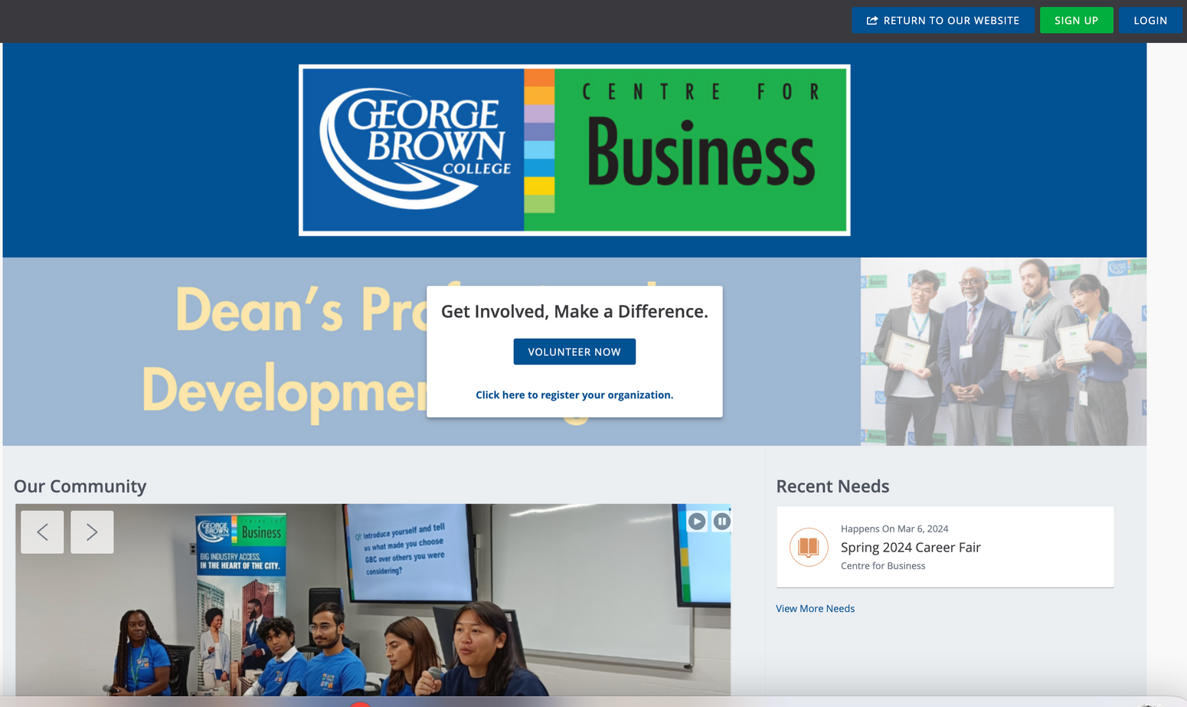

Sign Up - Open Account
  First name
  Last name
  GBC email
  Phone number
  Expected Graduation Semester
  Password
  Program code and name
  Select Interests
  Select Causes
  Become a fan of ‘Centre for Business’
  Email confirmation
CfB DEAN’S PROFESSIONAL DEVELOPMENT PROGRAM
GEORGE BROWN COLLEGE

Slide 16
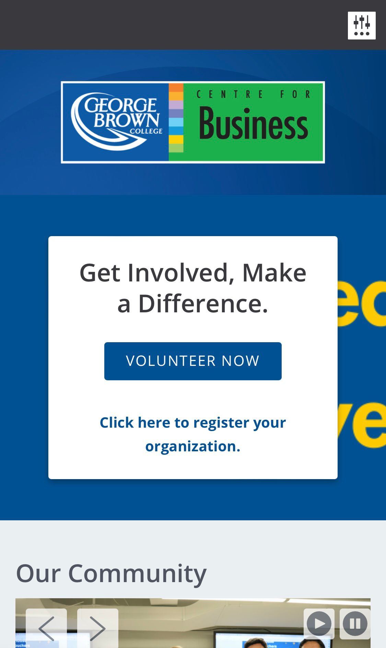
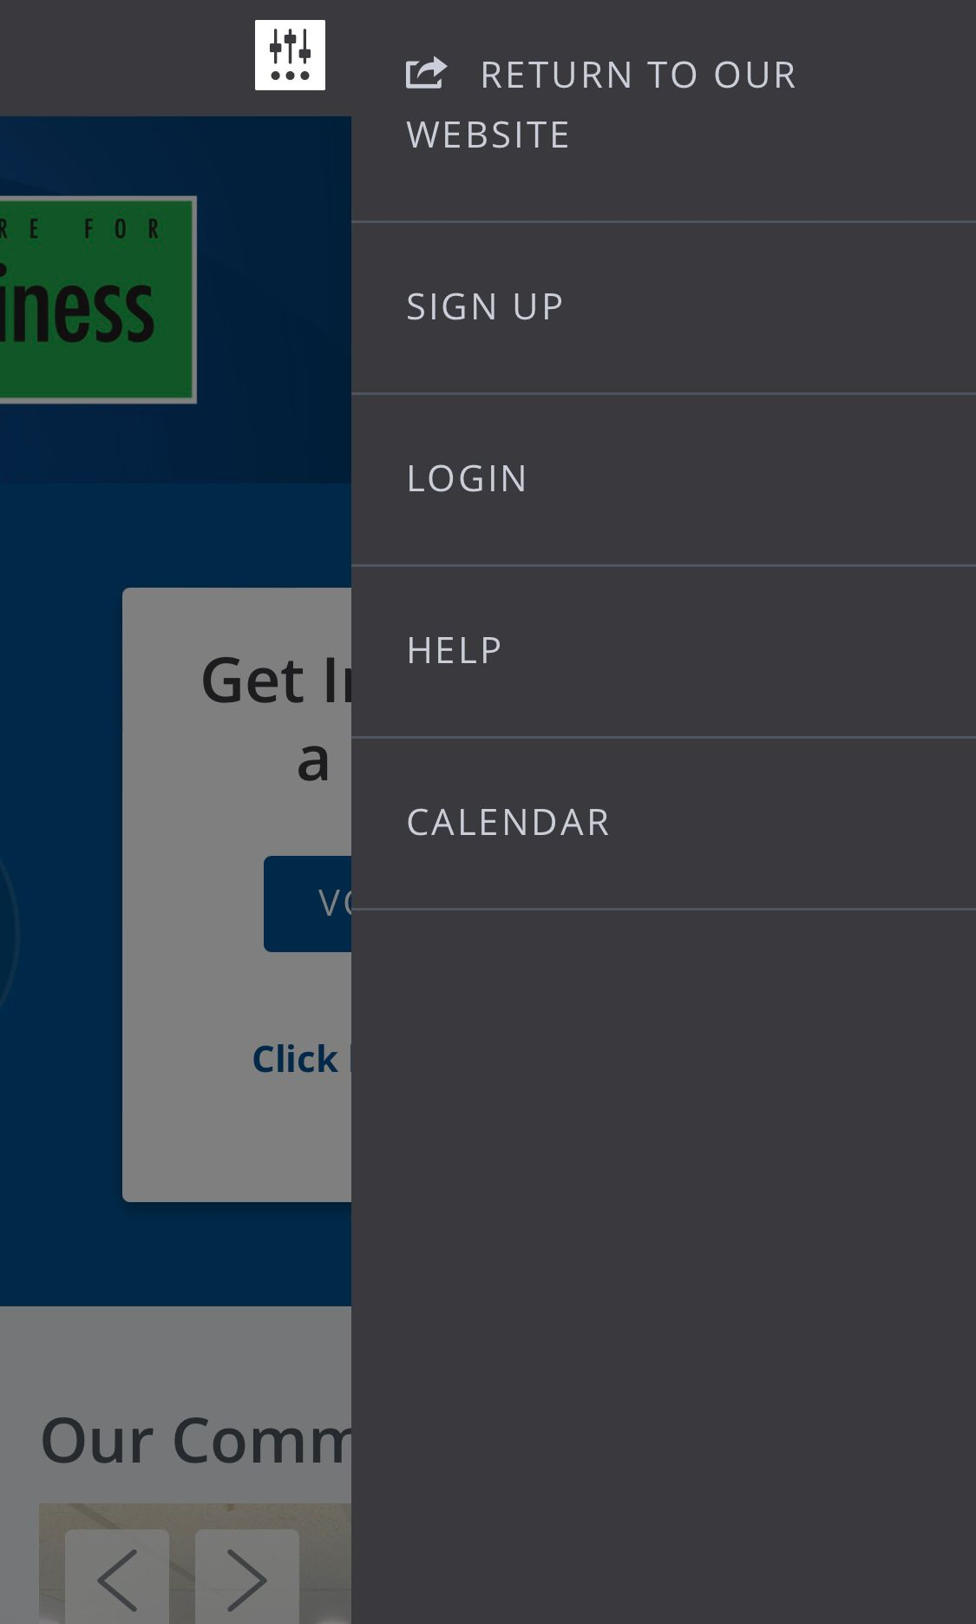
Sign Up - Open Account - Mobile
  First name
  Last name
  GBC email
  Phone number
  Expected Graduation Semester
  Password
  Program code and name
  Select Interests
  Select Causes
  Become a fan of ‘Centre for Business’
  Email confirmation
CfB DEAN’S PROFESSIONAL DEVELOPMENT PROGRAM
GEORGE BROWN COLLEGE

Slide 17
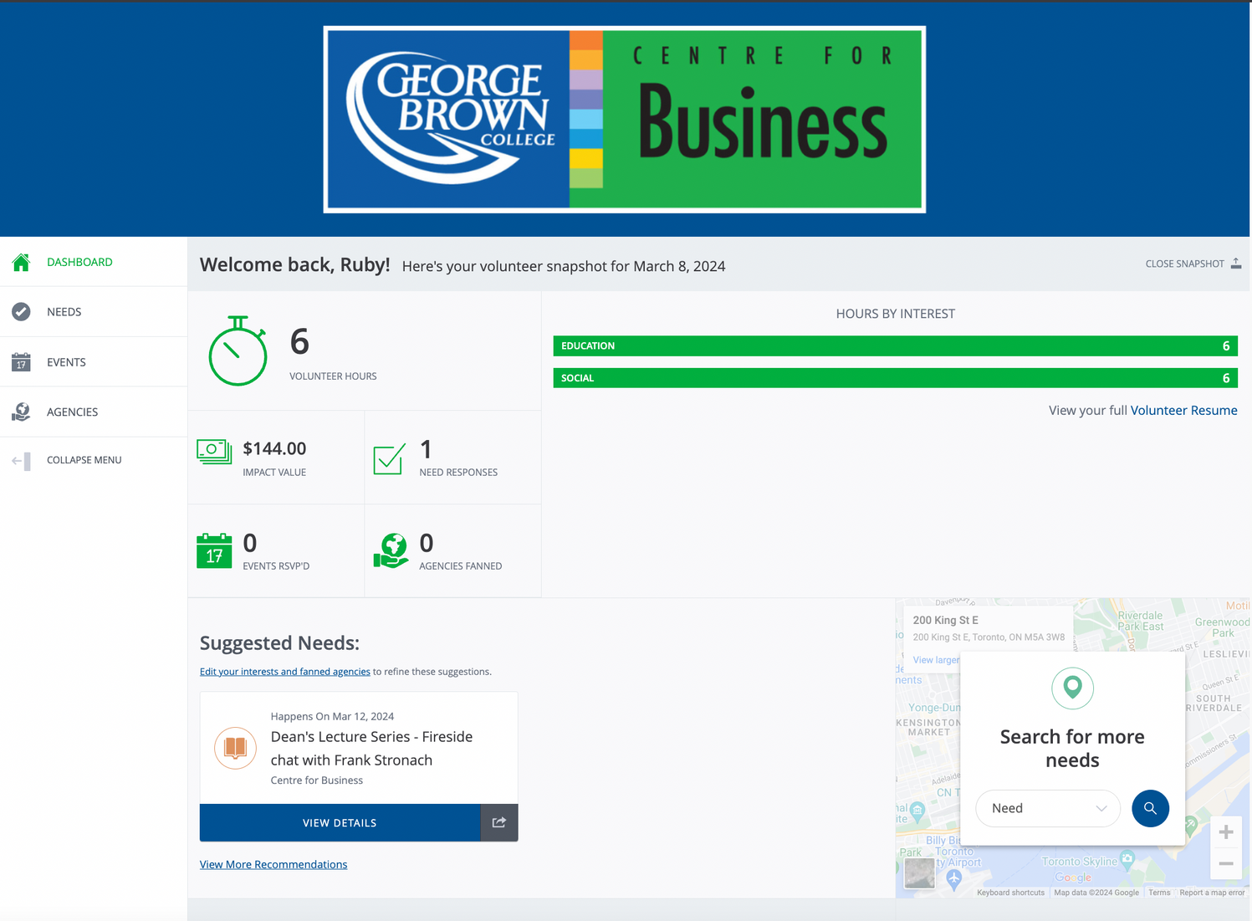
Respond - Volunteer Needs
CfB DEAN’S PROFESSIONAL DEVELOPMENT PROGRAM
GEORGE BROWN COLLEGE
  We will also send out email notification to students who registered DPDP after we put up the Volunteer Needs on DPDP portal.

Slide 18
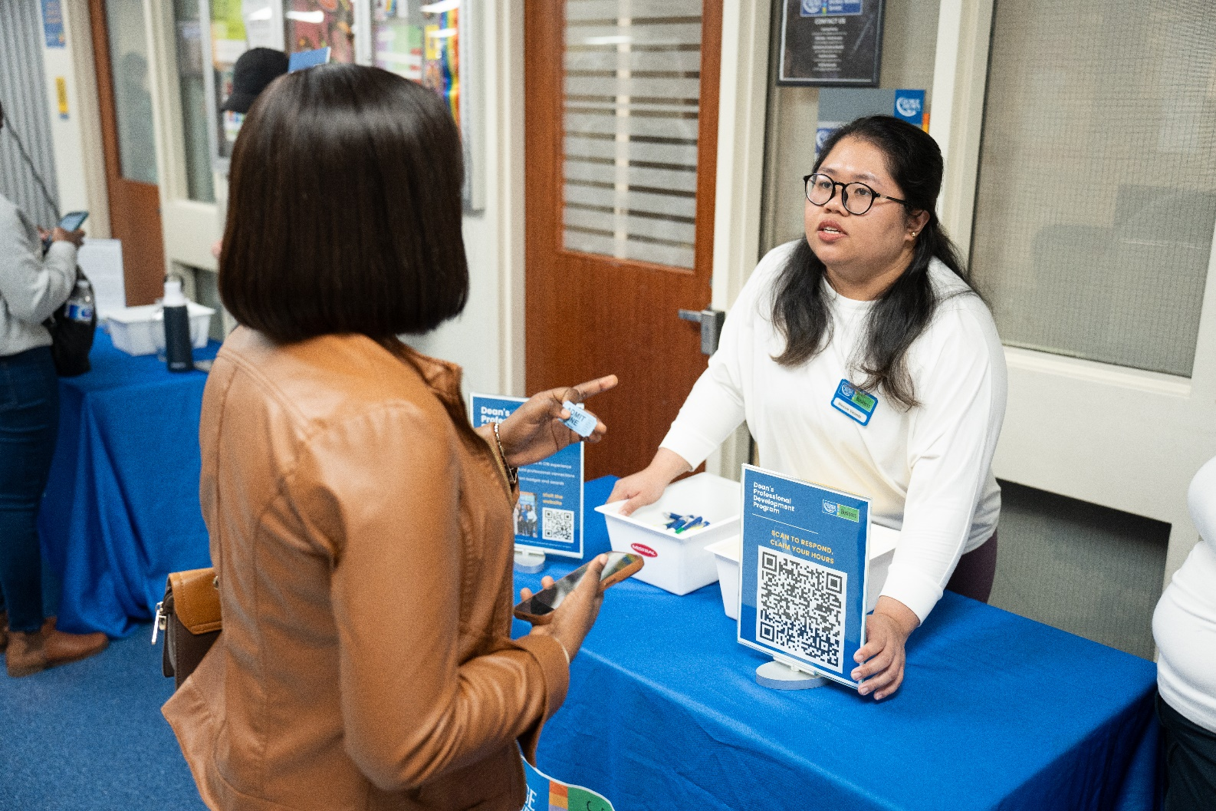
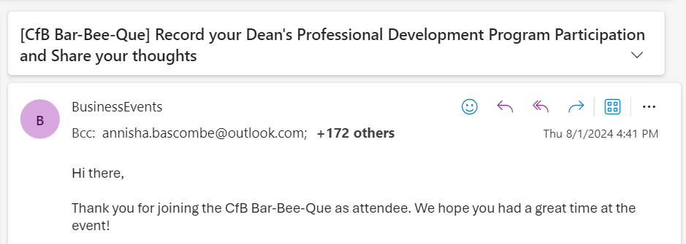
Respond - Event Needs
  Students have 2 ways to respond to Event needs as attendees to record participation and earn hour(s)
CfB DEAN’S PROFESSIONAL DEVELOPMENT PROGRAM
Scan to respond
to the Need at DPDP booth on event day
Follow instructions in email from
Business Events to respond to the Need
*Attendees will receive the email
within 1 week after the event ends
OR
GEORGE BROWN COLLEGE

Slide 19
Workflow – Other experience
CfB DEAN’S PROFESSIONAL DEVELOPMENT PROGRAM
Rewards
Confirmation
Hours will be added by the CfB team after the response due date.
Participation Record
Receive a follow-up email from the Business Events team
Sign-in/ Sign-up to DPDP Portal
Respond to the Need via a private link within the due date to confirm participation.
Eventbrite check-in (all events)
Committee list (clubs)
Program completion list (SAMP)
Case competition
participants list
Experience notice from Faculty
GEORGE BROWN COLLEGE

Slide 20
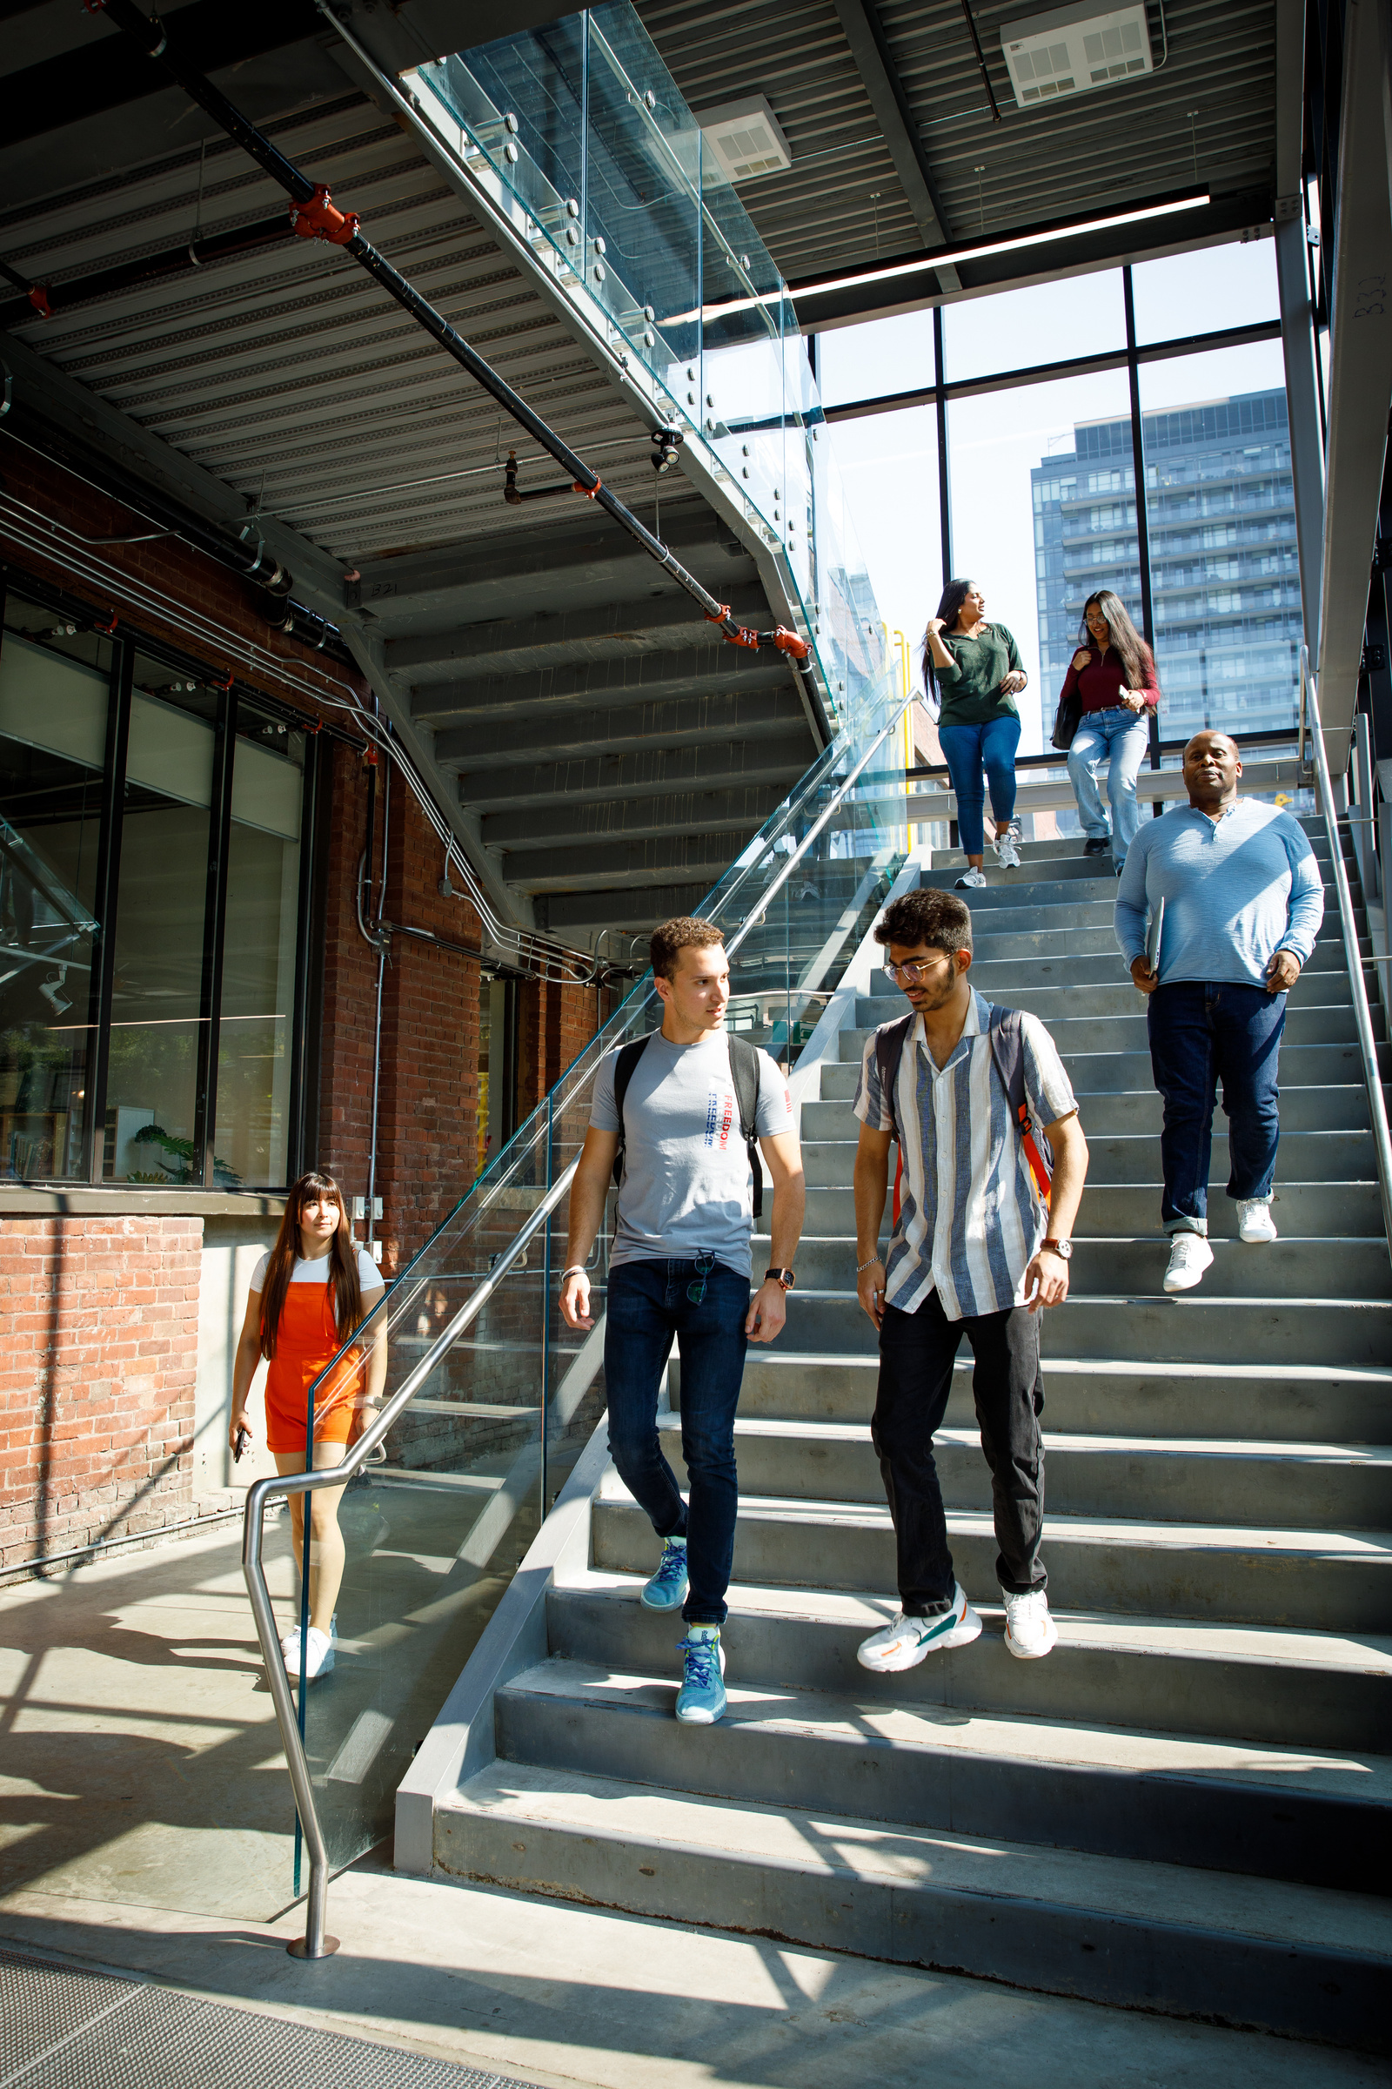
Contact
Centre for Business
business@georgebrown.ca
www.georgebrown.ca/business/contact
Centre for Business-
Marketing & Events Team
businessevents@georgebrown.ca

Slide 21
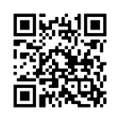


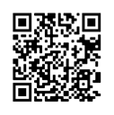

Follow Us on Social Media
Instagram: @gbc.business
LinkedIn: Centre for Business
Notes:
14

Slide 22
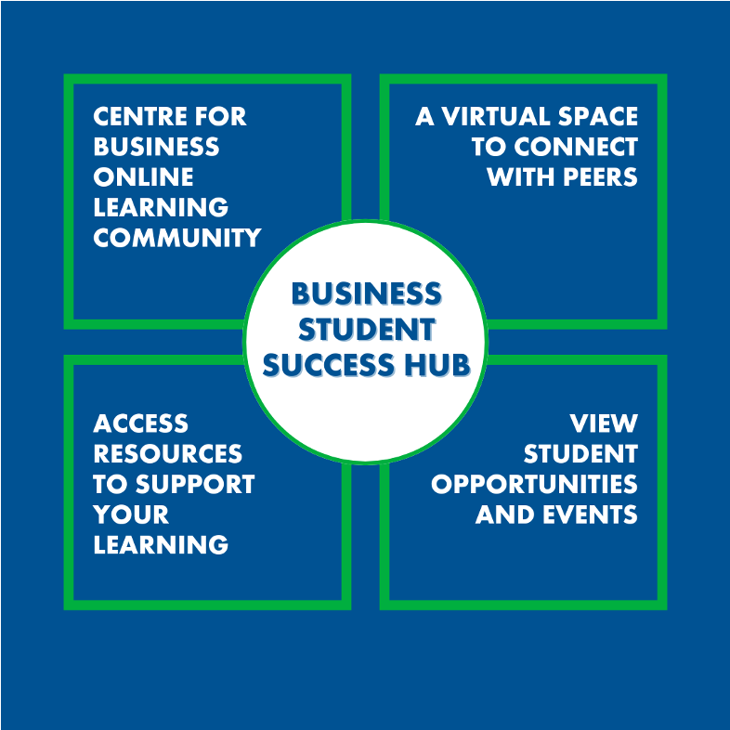
Business Students Success Hub (BSSH)
To access the Business Student
Success Hub log in to D2L Brightspace(learn.georgebrown.ca)
Under Communities and Organizations, click on Business Student Success Hub.
Notes:
14

