Slide 1
Alternative Assessment
A way to practice Universal Design for Learning
By Elena Chudaeva, CC BY

Slide 2
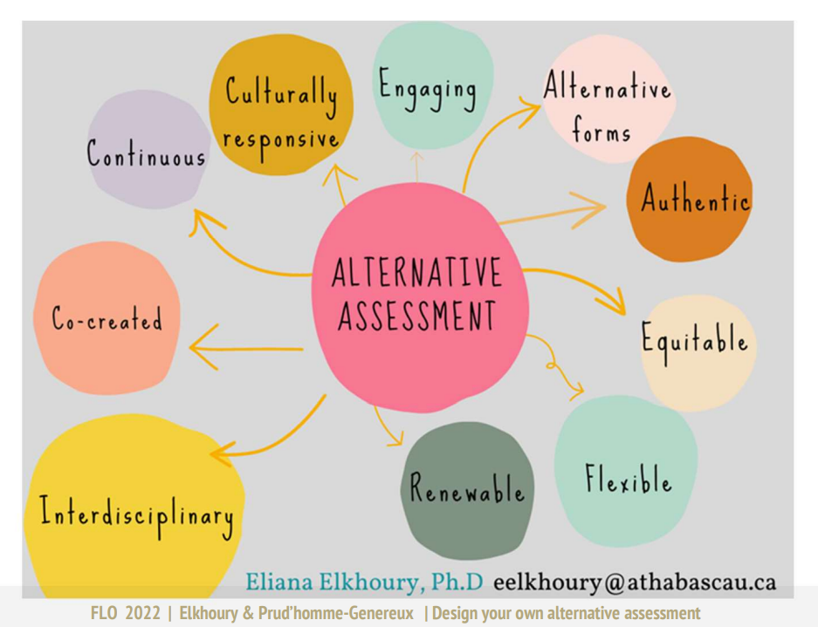
Alternative Assessment and Related Ideas

Slide 3
What is Alternative Assessment?
Adapted from BCcampus FLO MicroCourse, 2022
A way of thinking about assessment
The design, the implementation, the feedback, the grading
Assessment as learning, for learning, of learning
Formative or summative?
Wiliam and Black (1996, p. 544) remark that ‘all assessments can be summative… but only some have the additional capability of serving formative functions”
William, D, & Black, P. (1996). Meanings and consequences: A basis for distinguishing formative and summative functions of assessment? British Educational research Journal, 22(5), 537-548. http://www.jstor.org/stable/1501668

Slide 4
What is Alternative Assessment? (cont’)
A different way of doing assessment (exams, quizzes,...)
A different way to think about the questions
A different way to think about the tools used
A different way to think about the examples.
Adapted from BCcampus FLO MicroCourse, 2022

Slide 5
Why do we need alternative assessment?
Minimizing Cheating (academic integrity)
Assessing higher order skills of students according to Bloom’s Taxonomy
Motivating/ Engaging students
Making assessments fun
Equity
Adapted from BCcampus FLO MicroCourse, 2022

Slide 6
Resources
https://www.aupress.ca/books/120279-assessment-strategies-for-online-learning/
https://tlc.ontariotechu.ca/teaching/course-design/assessment-and-evaluation/alternative-assessment.php
https://uwaterloo.ca/centre-for-teaching-excellence/teaching-resources/teaching-tips/assessing-student-work/grading-and-feedback/rubrics-useful-assessment-tools

