Slide 1
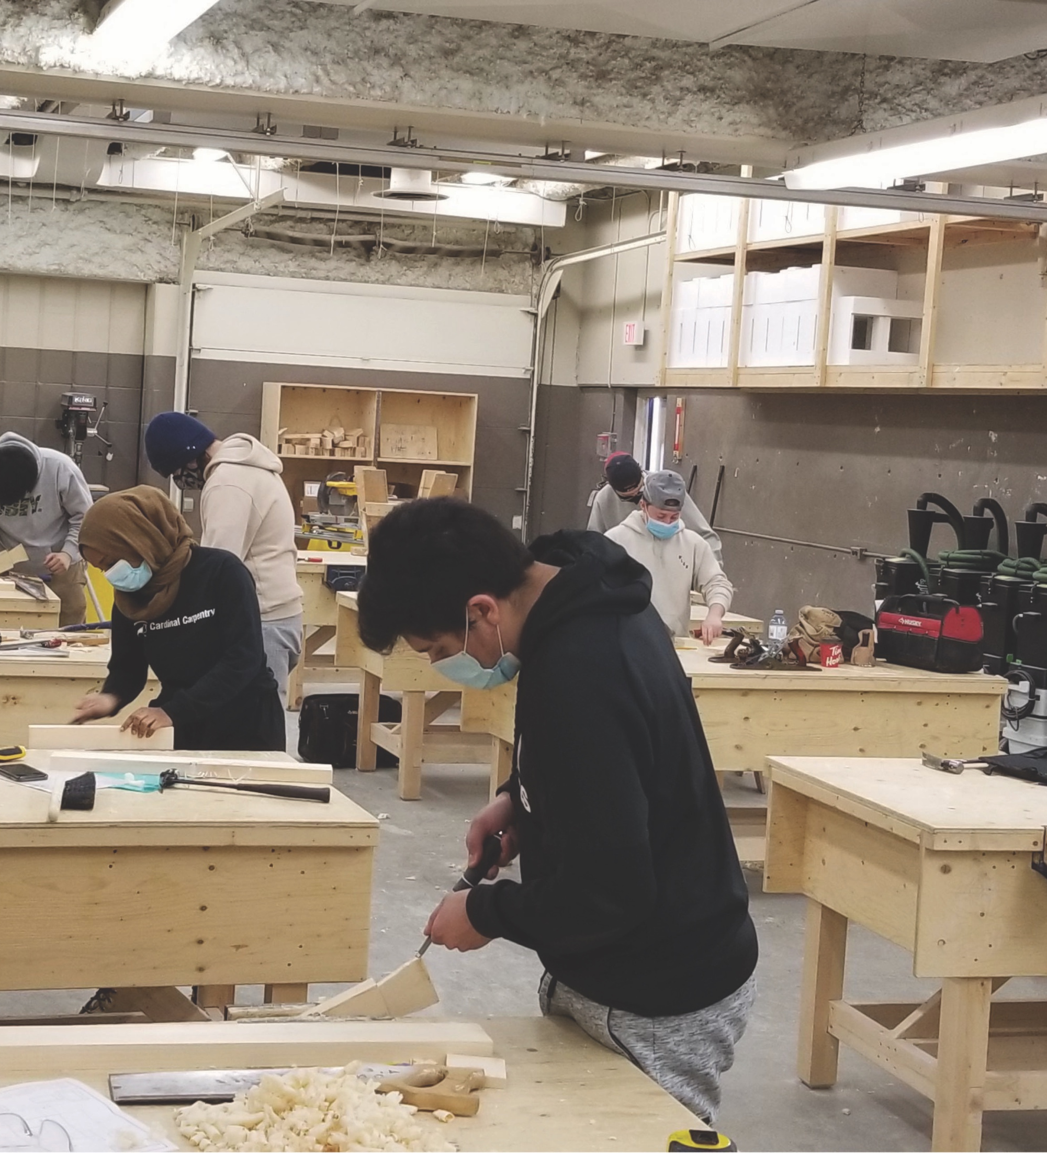
COVID-19
Awareness Training
Health, Safety and Wellness
April 5, 2021

Slide 2
Awareness Training Overview
The purpose of this awareness training is to provide information on the enhanced protection measures that have been established at GBC in response to growing cases of COVID-19 in the community.
We will discuss the following topics:
  COVID-19 Variants of Concern (VOC)
  COVID-19 Cases at GBC
  Health and Safety Requirements in Classrooms and Labs
  Wellness Ambassadors
  GBC’s Response to COVID-19 trends
  How You Can Help
  Communication to Students – ‘Take 5 for Safety’

Slide 3
Introduction
GBC is committed to the health, safety and wellness of our employees, students, and members of the public that access our campuses and learning spaces.
Our goal is to prevent the transmission of COVID-19 on our campuses while providing selective on-site teaching and learning activities. In doing so, we are reducing the risks of illness, personal and community impacts and added stress on our healthcare system.

Slide 4
Introduction
The College has taken a multifaceted approach to managing the risk of COVID-19.
Physical & Security Preparations
Preparing Staff & Students
Monitoring & Enforcement
Case Management and Contact Tracing
COVID-19 Response Team
Review safe work practices within each academic program
Awareness Training – Staff and Students
Ongoing communication to all staff and students
Active management of incoming International Students
Integration with Toronto Public Health and legislators
Wellness Ambassadors
Classroom protocols, personal protective equipment
Building access controls and screening process
Environmental Assessments
Signage, wayfinding, preparation of common space for eating / breaks
Collaboration with Vendors, Unions and Joint Health and Safety Committees
4

Slide 5
COVID-19 Variants of Concern (VOC)
A variant becomes a VOC when its changes have a clinical or public health significance that affects one or more of the following:
    transmissibility (spread)
    virulence (severity of disease)
    vaccine effectiveness
    diagnostic testing
Some VOCs may re-infect people who have recovered from COVID-19 or cause severe illness.
New dominant variants have more impact on the younger population, have easier spread and may cause more severe illness.
Vaccines approved for use in Canada provide protection against variants. There is ongoing research to determine if approved vaccines are effective in preventing disease from the new VOCs.

Slide 6
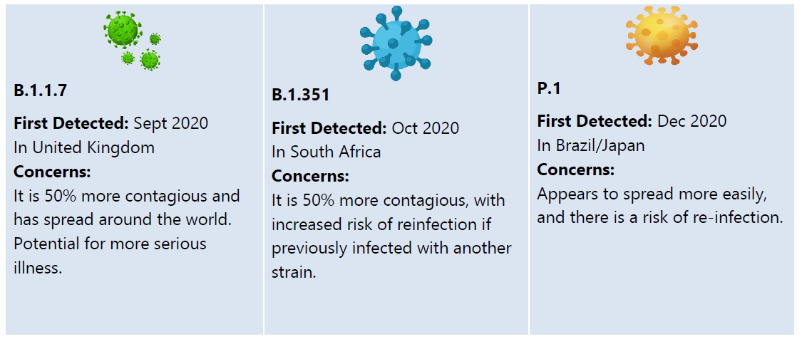
COVID-19 Variants of Concern
Three VOCs are known to be circulating in Ontario:
Source: Toronto Public Health (2021). "COVID-19 Workplace Information on Variants of Concern". Viewed: April 2, 2021
<https://www.toronto.ca/wp-content/uploads/2021/03/8e99-COVID-19-Workplace-Information-on-VOCs.pdf>

Slide 7
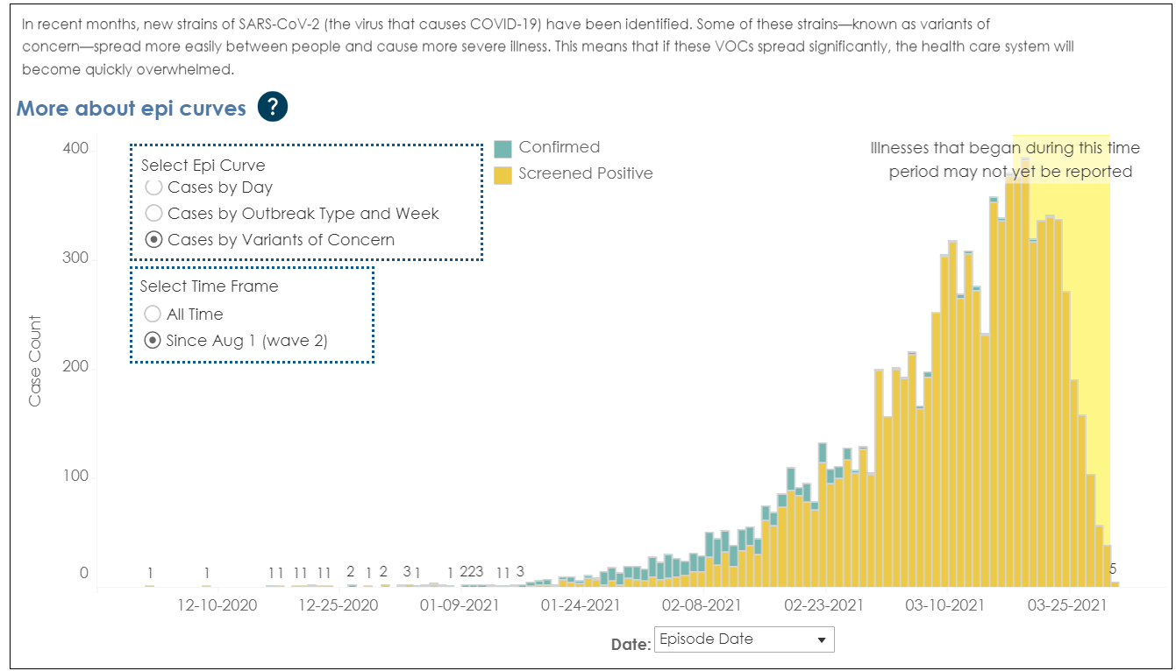
Rising COVID-19 VOC Infections Concern
Source: Toronto Public Health (2021). "COVID-19: Status of Cases in Toronto". Viewed on April 2, 2021.
<https://www.toronto.ca/home/covid-19/covid-19-latest-city-of-toronto-news/covid-19-status-of-cases-in-toronto/>

Slide 8
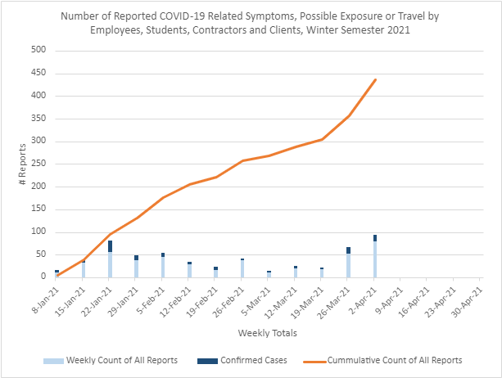
COVID-19 Cases at GBC
This semester, the COVID-19 Response Team has received over 430 reports of illness or exposure from members of our GBC community (employees, students, contractors and clients).
120 members of our community tested positive for COVID-19. Most of whom were not on campus.
19 individuals (employees, students, contractors or clients) were on campus when they were infectious.
We have had 1 on-campus transmission at WF.

Slide 9
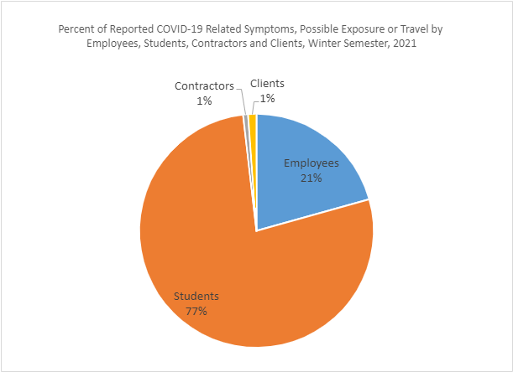
COVID-19 Cases at GBC
77% of the illness and exposure reports that the COVID-19 Response Team receives are from students.
Employees make up 21% reports.
Contractors and clients make up 1% each of all reports received.

Slide 10
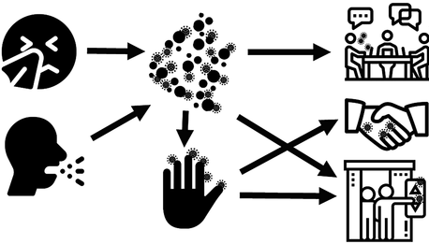
COVID-19 Cases at GBC
COVID-19 is spread mainly from person to person through droplets, close contact, and indirect contact.
DROPLETS
DIRECT CONTACT
INDIRECT CONTACT
Source: American Cancer Society, C. Chen and C. Chi (2020)

Slide 11
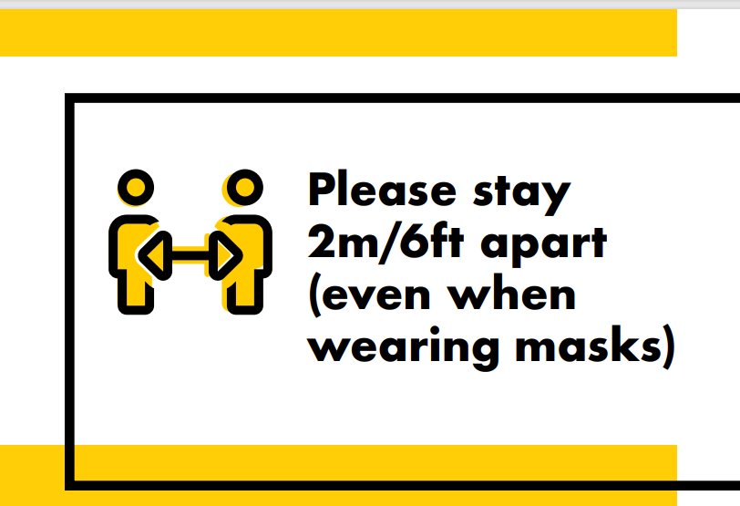
Health and Safety Requirements – Physical Distancing
Maintain physical distance of 2m from others, always, and avoid close contact.
Exceptions where physical distancing cannot always be achieved:
    Dental
    Nursing
    Early Childhood Education
Programs not mentioned above with the requirement for physical distancing must contact HSW for support on additional measures and enhancements in PPE.

Slide 12
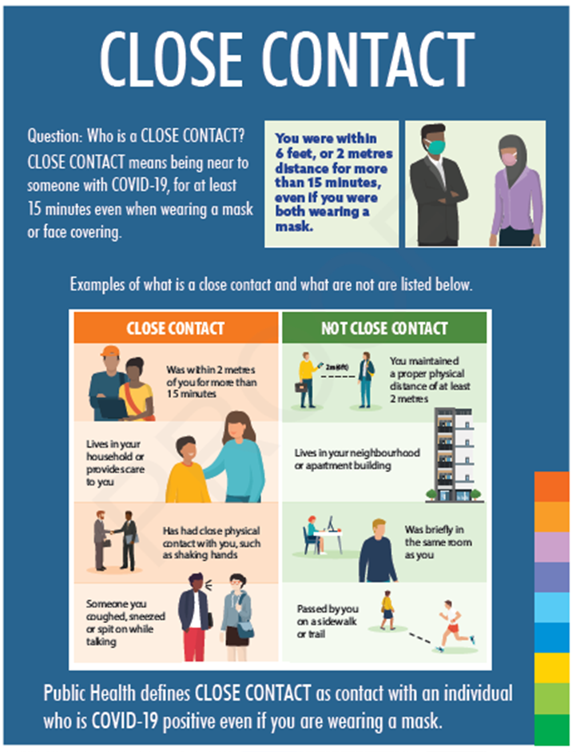
Health and Safety Requirements – Physical Distancing
What is Close Contact?
Close contact means being near (within 2 metres) to someone for 15 minutes or more, cumulative, even when you are both wearing masks.
Passing by someone briefly or keep a distance of 2 m or more is not close contact.

Slide 13
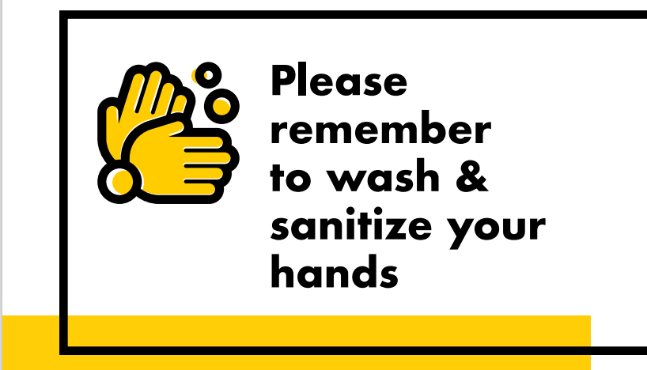
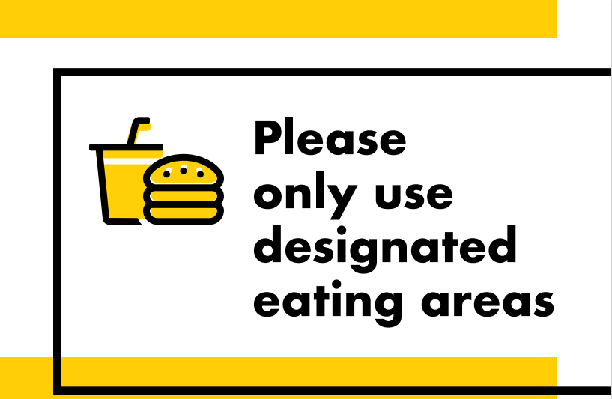
Health and Safety Requirements – Eating Areas
Eating areas have been designated and set up to prevent close contact.
If designated areas for eating have not be allocated for your area, please reach out to your chair or manager.

Slide 14
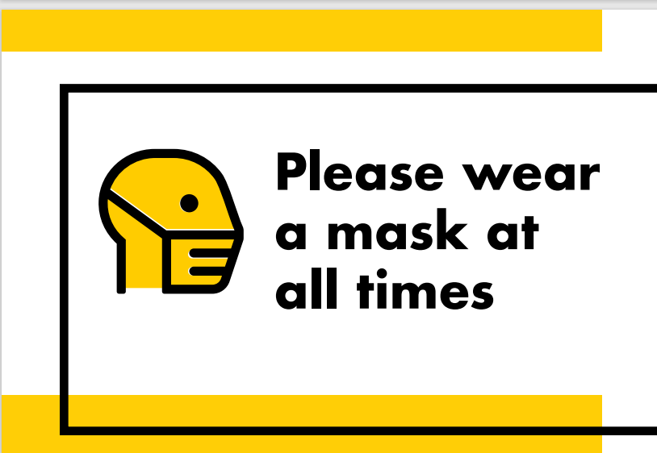
Health and Safety Requirements – Mask Use
Always wear your mask properly when at the college.
New medical masks are available for use on campus. These are Level 2 and Level 3 fluid-resistant surgical masks.
Where distancing cannot be maintained in the labs or workspaces, Level 3 masks and face shields must be used.
This level of enhanced PPE is currently in place for Dental, Nursing and ECE.

Slide 15
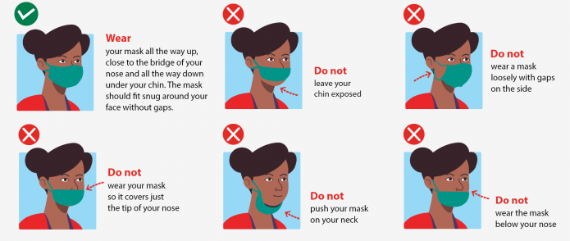
Health and Safety Requirements – Wearing a Mask Properly
Wear your mask all the way up close to the bridge of your nose and all the way down under your chin. The mask should fit snug around your face without gaps.

Slide 16
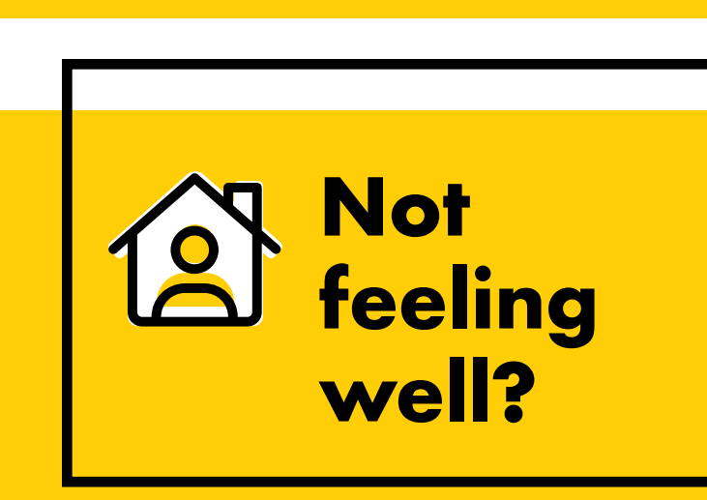
Health and Safety Requirements – Stay Home When Sick
Stay at home
Self-isolate immediately
Contact Toronto Public Health at 416-338-7600 or book a test at a COVID-19 testing location
Students: alert Student Counselling & wellbeing at georgebrown.ca/letstalkCOVID19
Employees: alert Health, Safety and Wellness at hsw@georgebrown.ca

Slide 17
GBC Wellness Ambassadors
Visible presence
Promote wellness on campus (students, employees, clients, contractors)
Increase awareness of COVID-19 protocols
Acknowledge when protocols are followed
Promote
Monitor common areas such as:
  Designated eating spaces
  Hallways
  Foyers
Observe
Remind
Remind everyone to follow COVID-19 protocols using verbal reminders, visual cues, and incentives
Report
Report findings at regular meetings with Manager of Student Life and HSW
Escalate issues to PSS, Manager of Student Life, and HSW

Slide 18
Immediate Actions at GBC
  Divisions are ensuring major outcomes are completed as soon as possible.
  Wellness Ambassadors and Security have increased monitoring in common spaces to ensure protocols are being followed.
  Wellness Ambassadors, Security Coordinators, and Facilities Management will be dropping into labs this week to observe and provide recommendations for further protocol enhancements.
  Facilities Management is reviewing and strengthen traffic flow protocols throughout our buildings.
  Awareness training sessions for faculty and employees.
  Surgical masks are available at all entrances for distribution.
  Enhanced PPE is available for labs where physical distancing is unavoidable.

Slide 19
How You Can Help
  Be a role model by following the COVID-19 Protocols.
  Review classroom movement, for example when accessing shared resources/areas, and activities and limit opportunities for close contact.
      Avoid large group huddles during demonstrations, instead have smaller groups so distancing can be achieved or use technology to cast the demo on a video screen.
      Shorten the duration of close contact activities to only what is essential and cannot be avoided.
      Where equipment or small workspaces are shared, have students take turns so there is only one at a time, and ensure time to disinfect items between use.
  Remind students and coworkers to social distance and avoid close contact whatsoever without approval and enhanced PPE.
  Advise program management or your manager where there are challenges.

Slide 20

Take 5 for Safety – COVID-19 Edition
1 KNOW YOUR LOCATION
  Campus Building
  Street Address
  Room Number
  Fire Exits
2 SECURITY & FIRST AID / MEDICAL
  Report all incidents, injuries, emergencies, security issues, suspicious or criminal activity to Public Safety & Security as soon as possible.
  For severe life-threatening emergencies call 9-1-1 and then contact security
  Immediately notify public safety and security if you start experiencing COVID-19 related symptoms while on campus
3 FIRE EVACUATION
  Exit building using nearest exit stairwell immediately when alarm sounds/flashes.
  Move away from building entrances and wait away from building.
  Individuals requiring assistance shall gather at an Emergency Evacuation Designated Waiting Area inside the building. Use call boxes to report your location. Emergency responders will assist.
  It might be hard to respect social distancing rules during an evacuation. Be sure to wear face covering and keep a safe distance from others!

Slide 21
Take 5 for Safety – COVID-19 Edition
4 COLLEGE EMERGENCIES
  The Emergency Notification Systems will provide
  important notifications on and off-campus.
  College Emergencies include:
    Lockdown
    Hold & Secure
    Shelter-in-Place
    Non-Fire Evacuation
5 PREVENTION
  Recognize, Assess, and Control hazards in your surrounding area.
  For Facilities or Housekeeping issues contact Facilities Help Desk.
  Non-emergency accidents, unsafe conditions, or other concerns must be reported to your supervisor or Health Safety & Wellness
  Effective safety communication includes everyone every day.
  Remember COVID-19 protocols.
    Physical distancing
    Wear a mask properly
    Wash hands often

Slide 22
Questions?

